Slide 1
Searching for digital sustainability:
From the right to work to the right to a decent income
Emanuele Menegatti
e.menegatti@unibo.it

Slide 2
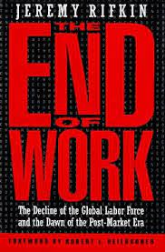
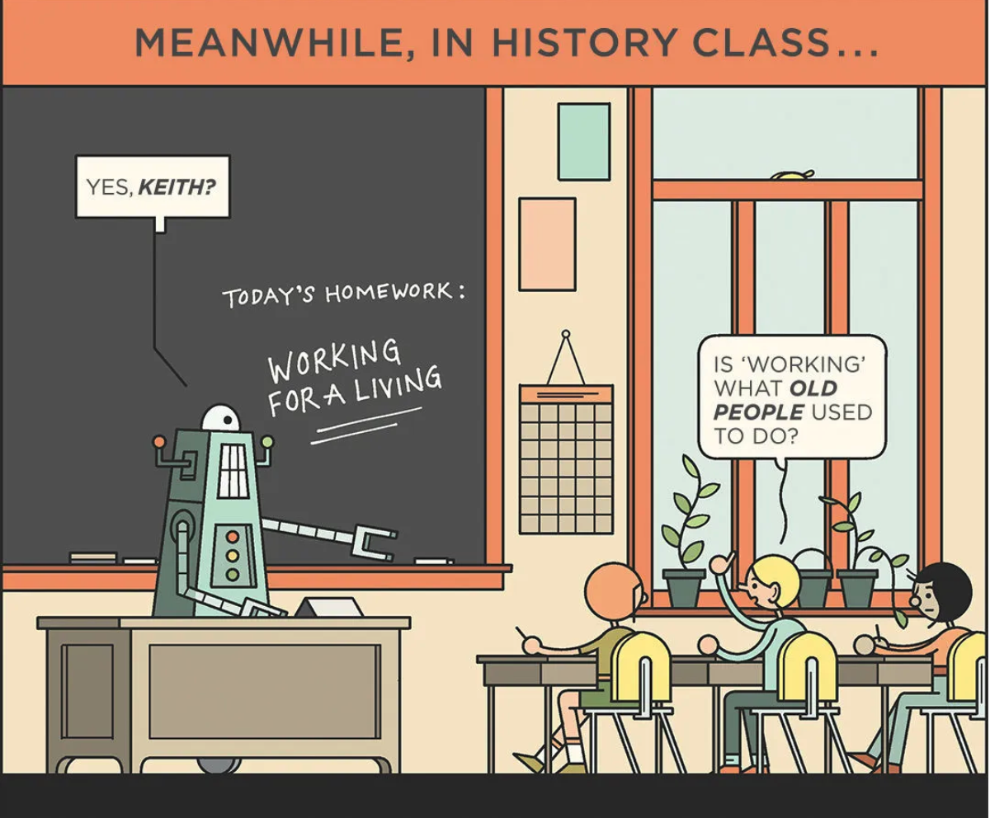
“47 per cent of total US employment is at risk of automation over some unspecified number of years”
Frey and Osborne (2017)
“Artificial Intelligence (AI) will create as many jobs in the UK as it will displace over the next 20 years”
(Source: BBC)
26% GDP growth in China and a 14% boost of GDP in North America by 2030.
(Source: PwC)
Notes:
Starting from 1995 provocative Rifkin book and some gloomy prediction which went viral in social media such as those made. Apparently we are moving towards a dystopian future well represented by this comic.
However, the prediction are rather conflicting. And it could not be different. At present it is hard to say whether a human will be needed to control a driveless car, such as it happens for planes or not. It is worth considering a parallel example: for cars it took 45 years to replace horses. For humans it probably will take longer. Perhaps very few jobs can be automated in their entirety.
One thing looks possible: AI will create jobs, perhaps as many it will displace. But in the long run. So in the short and medium term some displacement could occur
Another thing is certain: automation is increasing productivity, and thus GDP and profits

Slide 3
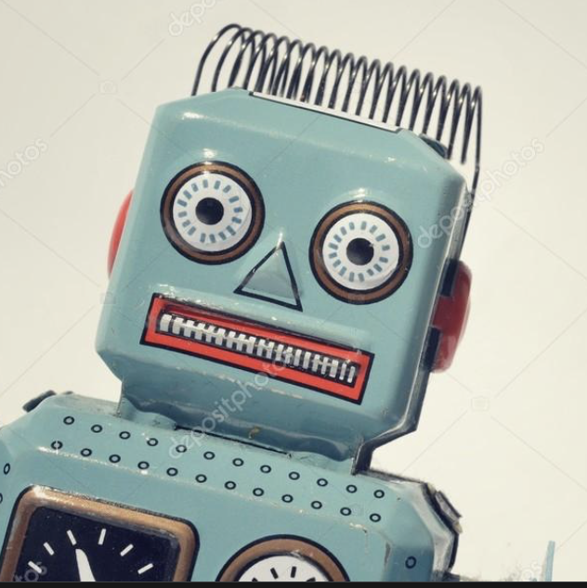
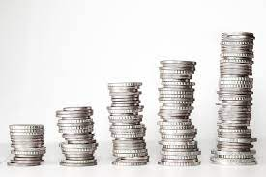
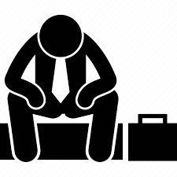
What role can be played by social law?
People in need
Unemployed
Precariously employed
Employed in a low income
Redistribution
Notes:
In this uncertain scenario, no matter which the right prediction will turn out to be right, social law can play an important role in copying with the reduction of work or the increasing casualization of work and in supporting the transition towards new skills. Moreover, redistribution is a way for sharing fairly the technological gain which is a way for enhancing the universal human right to ‘share in scientific advancement and its benefits’, Article 27.1 HDHR
Redistricution should take into account the uneven impact of automation:
- between labour and capital: powerful companies are grabbing most of the technological gains.
- across workers and industries. In general, people with lower levels of education will be more likely to be affected by automation and forced to switch job in order to keep employment; on the contrary, while higher-educated employees could be able to adapt to technological changes. Health, education, scientific and technical services are set to benefit from AI, whereas jobs in sectors such as manufacturing, transport, public administration could suffer disproportionately.
WE MIGHT START FROM ONE ASSUMPTION HARD TO DENY: the technological revolution is seriously increasing inequality, with
profoundly regressive effects on the distribution of income, first of all because powerful companies and their owners are getting the bigger slice of the cake.

Slide 4
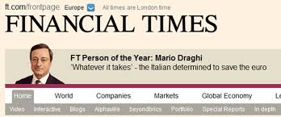
Need to change the paradigm of social assistance
Social Inclusion
Not enough work for all!
Current social security systems are not inclusive enough …
Income Support
(mainly by social insurance)
Work
Unemployed or unable to work
Right to Work
Social Insurance
Inclusive Schemes of Income Support
Social Transfers
Notes:
So far we have been used to consider work as the main means for social inclusion. Accordingly we have been used to target social protection to those who are unable to work mainly by social insurance, that is to say contributory schemes.
This reflects the work centered ethic of the XX century. However, work may be no longer for all. We have been assisting recently to jobless growths, giving raise to a large area of people and wokers in need but not covered by current systems, especially atypical workers, and especially those who are located outside the boundaries of traditional employment.
Workfare policies did not help. On the contrary they significantly contribute to the growing precarisation of work. Even in the wake of the digital revolution: i.e. gig-work. Pushing people into dead-end short-term jobs disrupts their own job searching, studying or training, potentially reducing their ability to escape from poverty and economic insecurity.
It is high time we realised that work centered idea of social inclusion and therefore income support based on Beveridge and Bismark modesl worked very well Social insurance worked adequately in an economy based largely on stable industrial full-time employment. They do not work in open, flexible economies with a large scale of precariat., with volatile earnings, not able to build adequate contributory records.
More universal scheme are need. And to move there, we probably need to switch from the right to work as means for social inclusion to universal systems of income support based on social transfer.

Slide 5
Drivers of poverty
Adjust wages to the cost of living
In-Work
Inadequate minimum wage
Insufficient working hours
Household composition
Insufficient social protection
Combat precarious work
Improve social transfer
Out-of-Work
Lack of employment opportunities
Insufficient social protection
Improve efficiency of labour markets policies

Slide 6
Tools
Universal Basic Income
Guaranteed Minimum Income
In-work benefit
Total income of a household, after tax and social transfer, divided by the number of household members converted into equalised adults
60% of median equivalised disposable income

Slide 7
Guaranteed Minimum Income v. Universal Basic Income
Means-tested
UNIVERSAL: independent of a person’s level of income, employment status or other indicators commonly used to determine eligibility for social security benefits
Household needs v. Households means
Conditional
- Availability for work, training programs, community services,
commitment to social integration, etc.
UNCONDITIONAL: no behavioral conditions (participate in employment, in training, etc.)
Notes:
The main schemes of cash transfers to households outside of any social insurance scheme or where social insurance benefits are not sufficient to cover basic needs are GMI and UBI

Slide 8
Disavantages of means-tested schemes
(compated to universal and unconditional)
Disincentives to work
Entails high costs (for administraions and claimants)
Stigmatizing, underminig social solidariety
Low take-up
Unfair when determined in family income
Conditionality puts pressure on people to take up precarious, low paid jobs
Notes:
Stigmatizating: Separating us from them
Low take-up: This is due to a reluctance to claim, from fear, shame or ignorance, mistakes
Singles get higher benefit than family when someone has a job

Slide 9
Is it the right time for a Universal Basic Income?
Arguments in favour
Social (justice)
Sharing the profits resulting from exploitation of privatized common-goods or extracted from a kind of common-knowledge
Freedom (to refuse bad jobs, to engage in voluntary and community work, to learn new skills, to have a family, to be lazy once in a while, etc.)
Security (preserve health and well being, ability to make rational decisions)
Strengthen solidarity (sense of belonging to a community)
Economic
Increase purchasing power of low-income people with a higher propensity to spend (boosting aggregate demand)
Automatic economic stabilizer ensuring more spending in recessions (see the pandemic)
Encouraging people to seek training and job opportunities in line with their skills (increase productivity)
An equitable way to respond to the disruption and inequality resulting from the displacement of human labour prompted by technology
Notes:
Therefore the choice between the various schemes of income support is just a matter of opportunity. UBI is just a matter of feasibility
Sharing the profits: a kind of social dividend paid from the collective wealth of society

Slide 10
Arguments against
Replaces most of social security schemes and grants savings from removal of means testing and behaviour conditions.
Unaffordable
Most people want to earn more if they could
Empirical analyses confirm that UBI does not reduce the labour supply
Negative incentives to work
Many people on BI would be engaged in non-remunerated activities still providing a contribution to society
Something for nothing
Notes:
It can be financed by the savings generated by the removal of regressive subsidies, such as those on fossil fuels.

Slide 11
Is it politically feasible?
UBI is gaining momentum
Massive cash transfer in pandemic times showed the benefit of an economic stabilizer
It has become nowadays rather clear the inadequacy of schemes of social insurance
New political parties and old established parties are increasingly embracing UBI

